Slide 1
Getting Your Résumé Read
By Jonathan Barnett
Based upon the article by Joel Spolsky

Slide 2
Introduction
Follow directions
Use proper grammar
Follow résumé etiquette
Know your audience
Be Human

Slide 3
Your Résumé
Your résumé is your first impression
Companies receive lots of applicants
  Résumés are used as a screening tool
This should show you’re a skilled and desirable employee
  Not a desperate and unqualified applicant

Slide 4
Follow Directions
Be qualified
Apply in the manner specified
  E-mail, mail, dropbox, etc

Slide 5
Use Proper Grammar
Capitalization is important
Use proper punctuation/spacing
Have someone review your résumé
  It should be bullet proof

Slide 6
Resume Etiquette
Use a professional e-mail
Use a cover letter
Don’t leave the e-mail text blank
  Can be spam filtered and is just rude
Use spell check
  Don’t misspell the company name or recipient

Slide 7
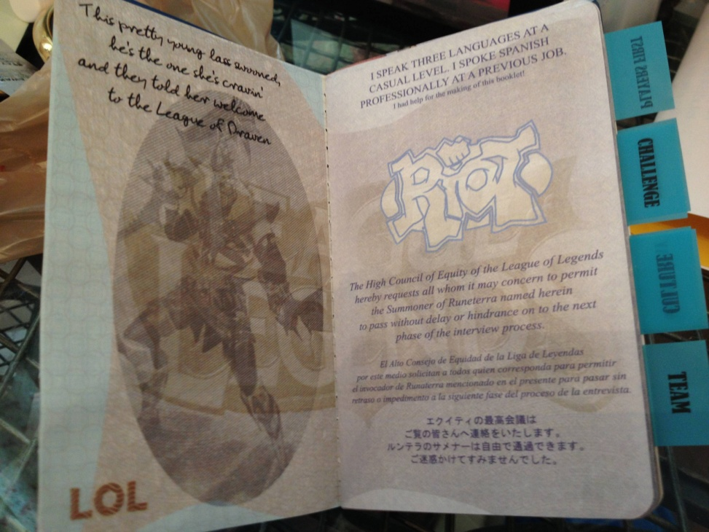
Know Your Audience
Research the company
Show passion
http://i.imgur.com/lvzmbWn.jpg

Slide 8
Be Human
Don’t send out a robotic reply
Give the reader a reason to connect with you
  You’re not a list of qualifications; you’re a person

Slide 9
Conclusion
Follow directions
Use proper grammar
Follow résumé etiquette
Know your audience
Most importantly: be human

Slide 10
References
http://www.joelonsoftware.com/articles/ResumeRead.html
http://www.reddit.com/r/leagueoflegends/comments/1kbqyk/lolthemed_passport_resume_and_what_it_taught_me/

